Slide 1
ENGR 12
Dr. Mandala
Notes:
Down

Slide 2

Seating Choice

Slide 3
Your feedback
Overall positive. Yay!
<25% of 145 students I teach, have minor criticism.
‘Slow down’
‘Explain with better examples’
‘Release assignments earlier’
‘Happy you weren’t deported’ – so am I.
‘I like live coding’– I like it too!
<2% mention ‘teach what’s on quiz/hw/test’

Slide 4

Class Lecture
Homework
Final Test
Handouts
Quiz
Outside world

Slide 5

Class Coding
Homework
Final Test
Handouts
Quiz
Outside world

Slide 6

Write the steps for…
Creating a game of tic-tac-toe
3x3 table
Players add a mark/symbol each turn
Marks in a row, col, or diag, wins.

Slide 7

STEP 1: Define the function
How do you let MATLAB know what is the function equation?
Example:
Method 1: Entering the function as a string (will not be supported in future)
f=‘sin(x)./(x.^2+1)’
Method 2: Creating a MATLAB function (m-file)
function y=eq1(x)
…
Method 3: Creating an anonymous function (recommended)
f=@(x)sin(x)./(x.^2+1);

Slide 8
STEP 2: analyze the function
For example, to plot the defined equation you can use fplot
>> f=@equation1;
>> fplot(f,[-10 10]);
Several MATLAB built-in functions can help analyze engineering equations
Function | description
fplot | Plots 2D mathematical function
feval | Evaluates a mathematical function
fzero | Finds roots of a mathematical function
fminbnd | Finds minima of mathematical functions
quad,quadl | Numerical integration
trapz | Trapezoidal numerical integration
diff | Numerical differentiation

Slide 9
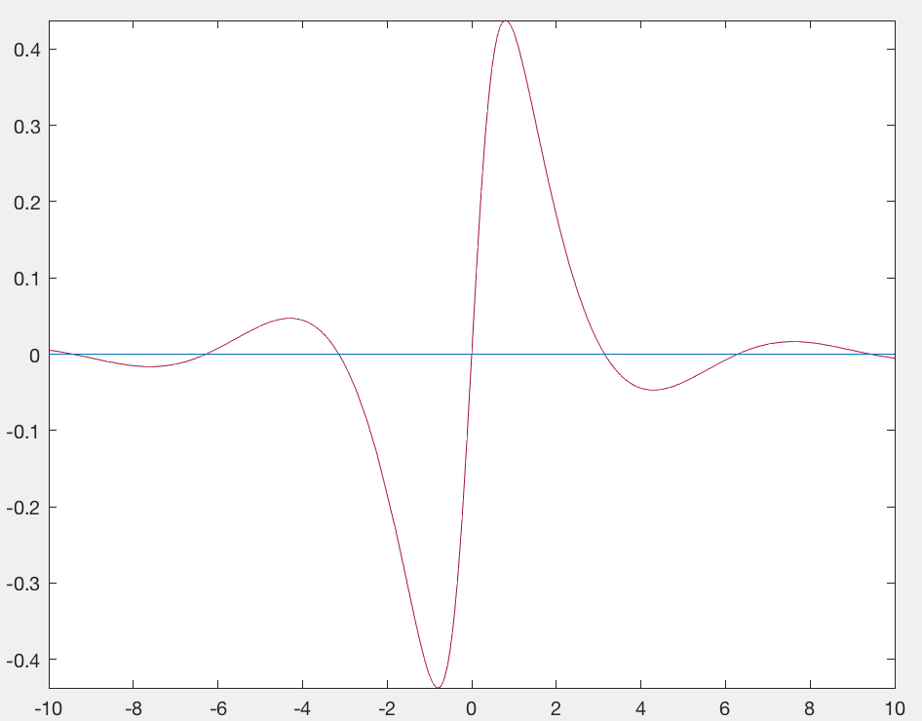
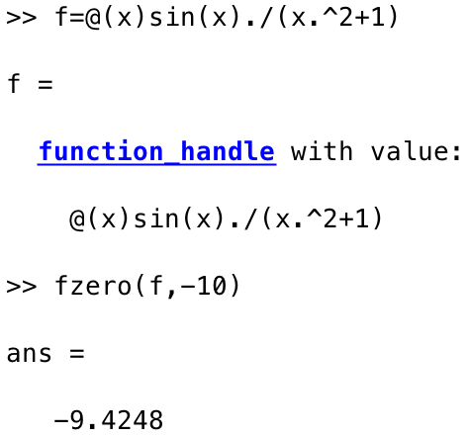
Finding Roots
fzero command returns roots of a function beginning at a starting point
fzero(fun,initial_guess)
fun=function handle
initial_guess=starting point on input variable (x), MATLAB creates a small interval that include initial_guess and searches for sign change.
Visual examination reveals first root is close to x=-10
fzero return x values
Notes:
Finds closest value to initial guess.

Slide 10
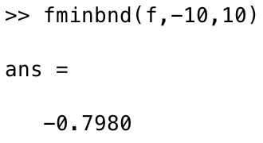
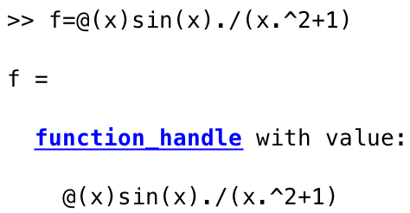
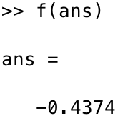
Finding local minima
fminbnd can find the local minima within a bounded x-space (or between two x-values)
fminbnd(fun,xmin,xmax)
fun= function handle
xmin=start point
xmax=end point
fminbnd returns x-values
f(x) gives y-values or the minima

Slide 11
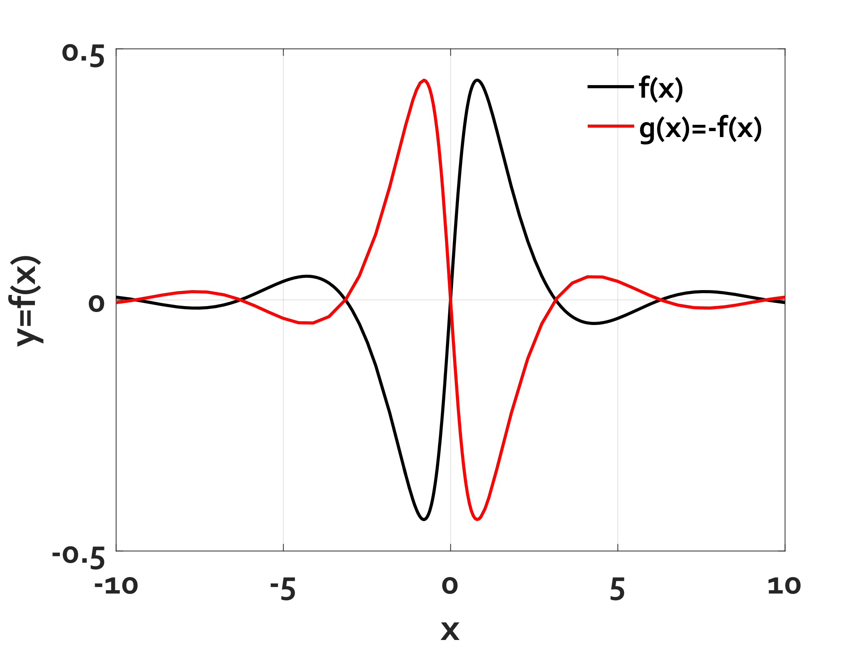
How do you find maxima?
There does not exist a built-in MATLAB function to calculate maxima.
To calculate the maxima of function f(x)
Negate the function (lets call it g(x))
Find minima values of x for the function g(x), lets say xmin
Find corresponding y-value in function f(xmin)

Slide 12
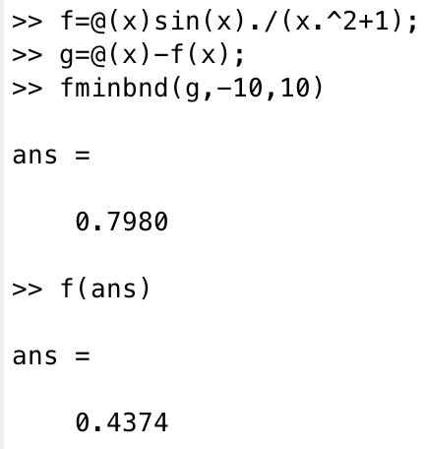
Steps to find maxima of function
Function f maxima
Define function f
Define negative of function f
Find minima for function g
Find function f value for minima of function g

Slide 13
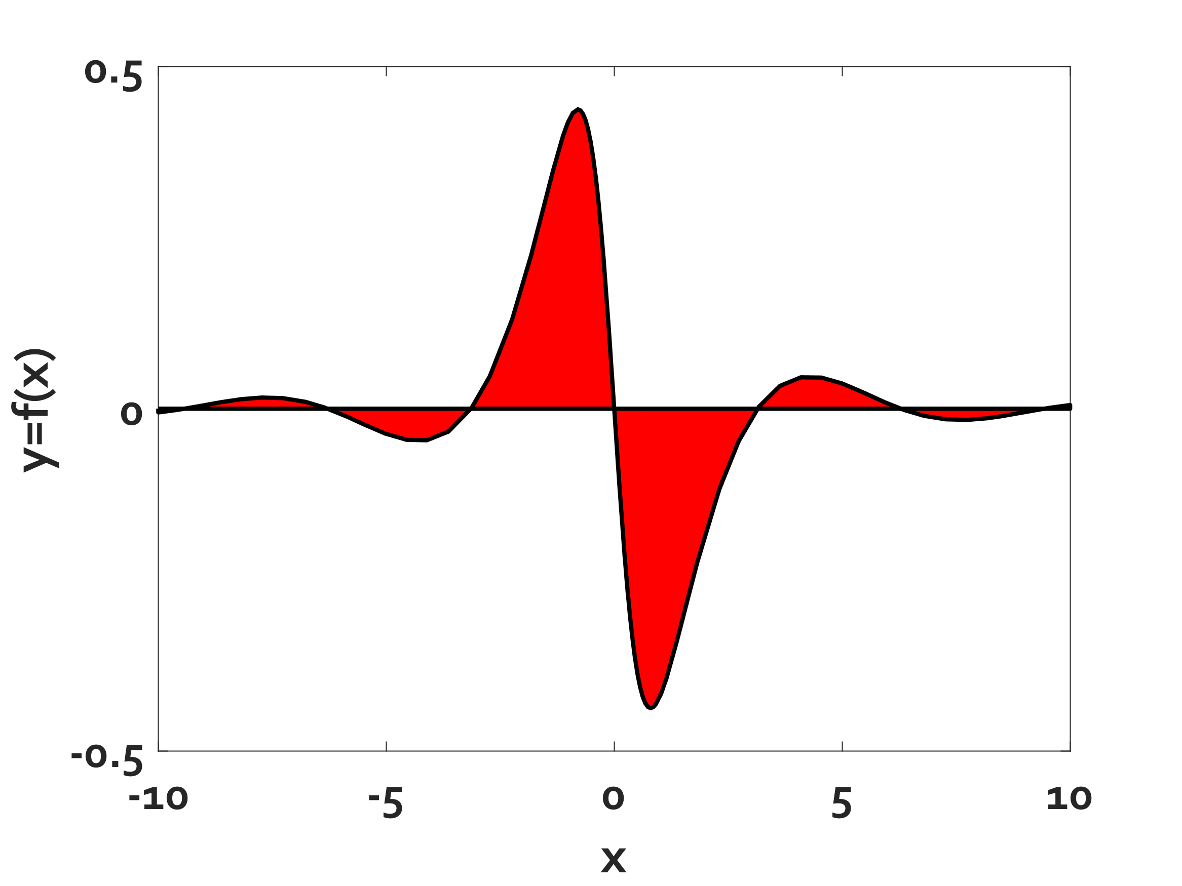
Numerical integral
Integral over function:
Find area between roots and sum them all
Method 1: Use trapz
trapz(x,f(x))
x=array of x-values
f(x)=array of corresponding y-values
Method 2: Use quad or quadl
quad(fun,xroot1,xroot2)
quadl(fun,xroot1,xroot2)
fun=function handle
xroot1=x-value of root 1
xroot2=x-value of root 2
Area1+Area2+Area3+Area4+Area5+Area6
Notes:
Refer to in-class demo

Slide 14


Numerical Differentiation
Much more complex!
To find differential at a point, use diff to calculate slopes
diff(fun,x_bounds)
fun=function handle
x_bound=an array containing xmin and xmax
Using diff finds differential at mid-point of xmin and xmax
$\underset{→}{in MATLAB} \frac{DIFF(f\left(x\right))}{DIFF(x)}, x=[x1 x2]$ or step size

Slide 15
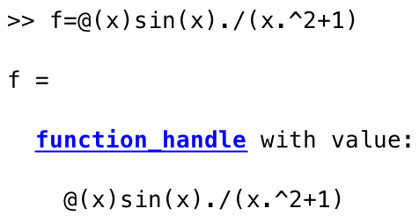


Numerical Differentiation method
Define function
Set range of x-values for function
Set step size
Calculate differential

Slide 16
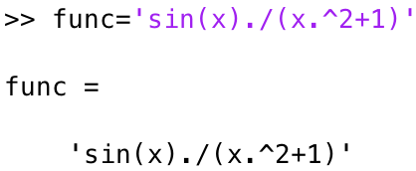
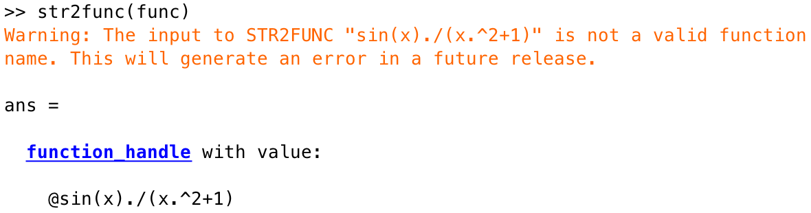
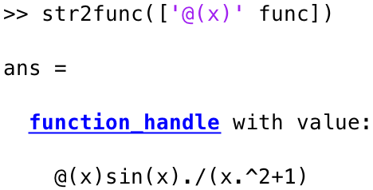
Convert a string into function
func contains a string representing the function
Does not look like anonymous function handle!
Concatenate ‘@(x)’ and voila! Looks like anon function now.^{magic}

Slide 17
Working with images (Guess)
How does MATLAB store images (format or datatype of image data in MATLAB)?
What would be the size of variable containing a 100p x 100p color image?

Slide 18
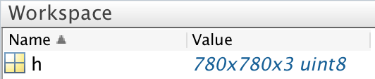

Working with images
Use imread to read image data from current working directory (or any directory if filename contains absolute pathname).
Use imshow to display image stored in MATLAB workspace variable.

Slide 19
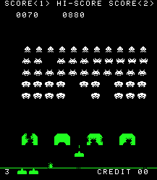

Videogames, then and now…
1978
2001-
What is common?
Notes:
Random Fuzziness

Slide 20
Random Number Generator
rand([size_of_array])
Generate random numbers from uniform distribution (between 0 and 1)
randn([size_of_array])
Generate random numbers from normal distribution (mean 0 and variance 1).
randi([RANGE, size_of_array])
Generate pseudo-random INTEGERS from distribution RANGE
If RANGE=100; randi generates integers from 1:100
If RANGE=[1 10]; randi generates integers from 1:10
To avoid repeated numbers, use randperm

Slide 21
How to randomize
Flip coin
6-sided dice
tic-tac-toe

Slide 22
Download handout
Download and work on ANY handout

